Slide 1
MONORAMA CONSULTING TOOLKIT
Here is where your presentation begins

Slide 2
CONTENTS OF THIS TEMPLATE
Here’s what you’ll find in this Slidesgo template:
A slide structure based on a consulting sales pitch, which you can easily adapt to your needs. For more info on how to edit the template, please visit Slidesgo School or read our FAQs.
An assortment of graphic resources that are suitable for use in the presentation can be found in the alternative resources slide.
A thanks slide, which you must keep so that proper credits for our design are given.
A resources slide, where you’ll find links to all the elements used in the template.
Instructions for use.
Final slides with:
The fonts and colors used in the template.
A selection of illustrations. You can also customize and animate them as you wish with the online editor. Visit Storyset to find more.
More infographic resources, whose size and color can be edited.
Sets of customizable icons of the following themes: general, business, avatar, creative process, education, help & support, medical, nature, performing arts, SEO & marketing, and teamwork.
You can delete this slide when you’re done editing the presentation.

Slide 3
01
02
TABLE OF CONTENTS
03
04
PROBLEM & SOLUTION
Here you could describe the topic of the section
MARKET ANALYSIS
Here you could describe the topic of the section
OUR PROCESS
Here you could describe the topic of the section
OUR CONSULTANTS
Here you could describe the topic of the section

Slide 4
OUR COMPANY
MERCURY
Mercury is the closest planet to the Sun and the smallest one in the Solar System

Slide 5
PROBLEM & SOLUTION
01
You can enter a subtitle here in case you need it

Slide 6
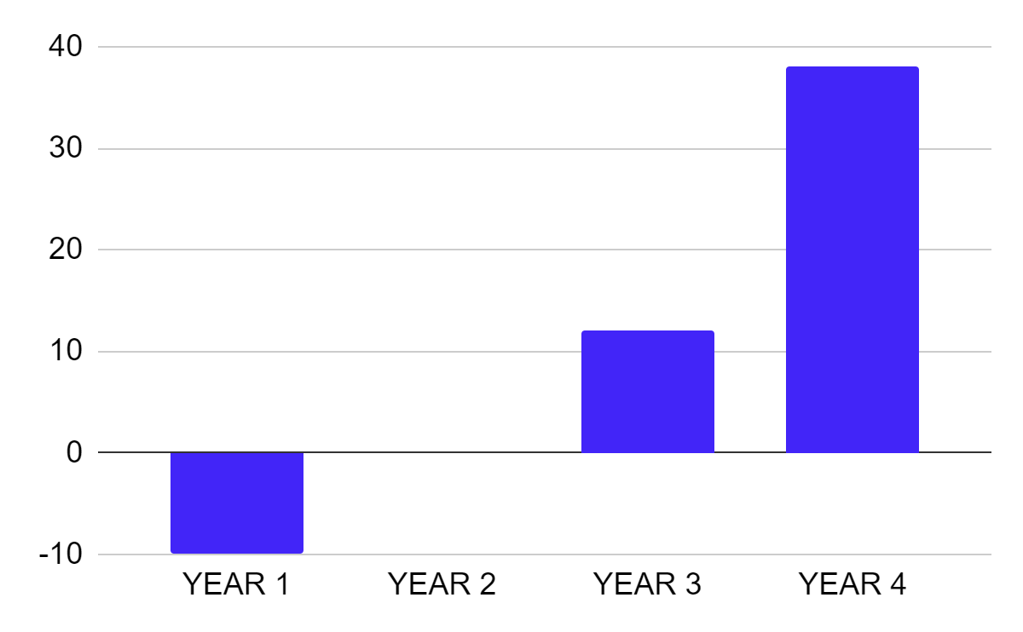
PROJECT CASH FLOW
+15%
Mercury is the smallest planet
+37
Jupiter is the biggest planet
To modify this graph, click on it, follow the link, change the data and paste the new graph here

Slide 7
UNDERSTANDING THE PROBLEM
MERCURY
Mercury is the closest planet to the Sun
VENUS
Venus is the second planet from the Sun
SATURN
It’s composed mostly of hydrogen and helium

Slide 8
MAIN COMPETITORS
 | JUPITER | NEPTUNE | SATURN
 | Yes | No | Yes
 | No | Yes | No
 | No | Yes | Yes

Slide 9
MATURITY MODEL
BASIC
BELOW AVERAGE
AVERAGE
ADVANCED
WORD CLASS
PROCUREMENT STRATEGY
OUR COMPANY
MAIN COMPETITOR
HUMAN RESOURCES
PROCUREMENT PROCESS
TECHNOLOGY
SUPPLIER RELATIONSHIP

Slide 10

OUR SOLUTIONS
VENUS
Venus is the second planet from the Sun
MERCURY
Mercury is the closest planet to the Sun

Slide 11
PEST ANALYSIS
POLITICAL
SOCIAL
Mercury
Mars
Saturn
Mercury
Mars
Saturn
ECONOMICAL
TECHNOLOGY
Venus
Neptune
Jupiter
Venus
Neptune
Jupiter

Slide 12
VALUE CHAIN ANALYSIS
MERCURY
VENUS
SUPPORT ACTIVITIES
JUPITER
MARS
PRIMARY
ACTIVITIES
NEPTUNE
SATURN

Slide 13
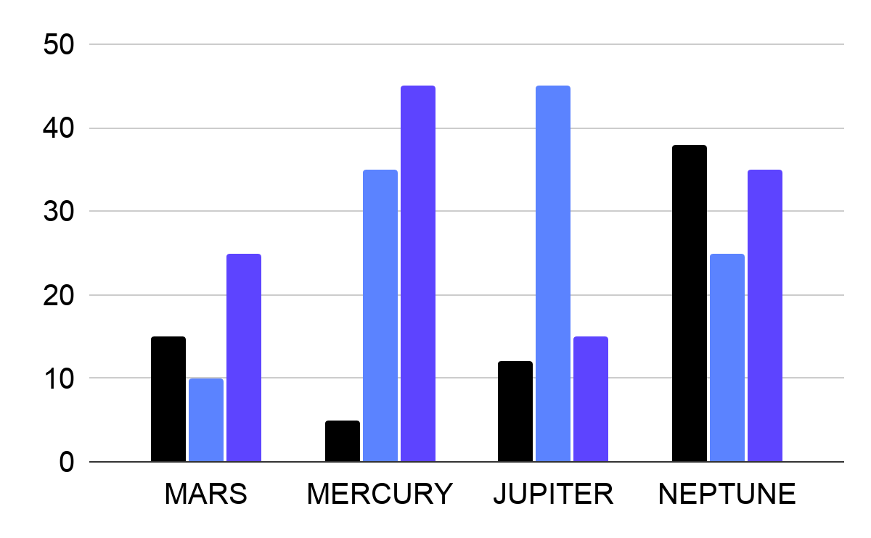
MARKET RESEARCH
MARS
MERCURY
Mercury is the smallest planet
JUPITER
Jupiter is the biggest planet
NEPTUNE
To modify this graph, click on it, follow the link, change the data and paste the new graph here
Neptune is the farthest planet

Slide 14
ANSOFF GROWTH MATRIX
Market Development Strategy
Diversification Strategy
CURRENT
PRODUCT
Market Penetration Strategy
Product Development Strategy
NEW
CURRENT
NEW
MARKET

Slide 15
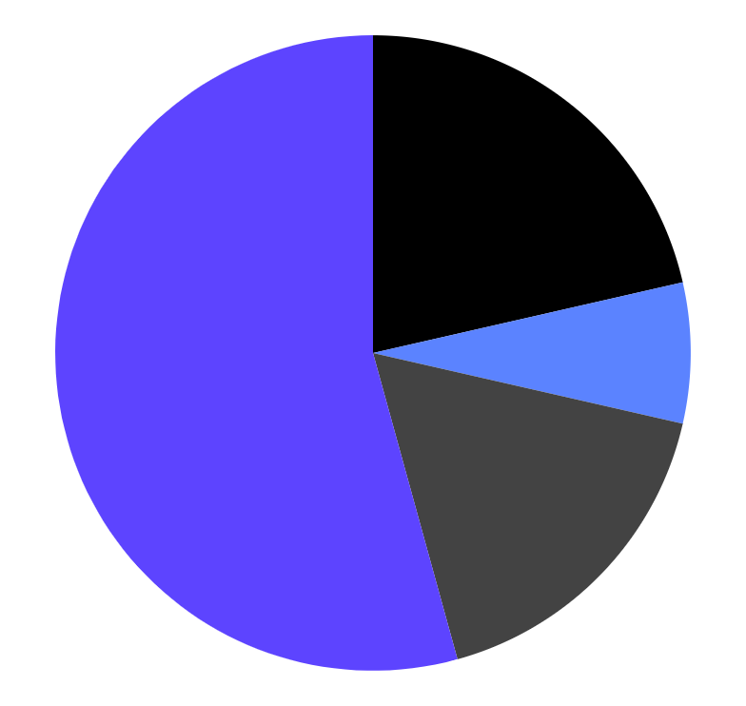
TARGET
$450
INTERESTS
Average Sale Per Customer
VENUS
20%
GENDER
MARS
53%
10%
NEPTUNE
60%
40%
17%
MERCURY
To modify this graph, click on it, follow the link, change the data and paste the new graph here

Slide 16
ANALYSIS
Mercury is a small planet
15,123
Mars is a very cold place
14,596
Saturn is the ringed one
36,548
Jupiter is the biggest planet
26,782

Slide 17
COMPETITOR COMPARISON
COMPANY NAME
30
COMPANY NAME
20
AVERAGE MARKET GROWTH
COMPANY GROWTH, %
COMPANY NAME
COMPANY NAME
10
0
0
10
20
30
40
MARKET SHARE, %

Slide 18
WHOA!
This could be the part of the presentation where you can have a little break and share an anecdote

Slide 19
“This is a quote, words full of wisdom that someone important said and can make the reader get inspired.”
—SOMEONE FAMOUS

Slide 20
UPCOMING GOALS
Do you know what helps you make your point clear? Lists like this one:
They’re simple
You can organize your ideas clearly
You’ll never forget to buy milk!
And the most important thing: the audience won’t miss the point of your presentation

Slide 21
BUSINESS ROADMAP
2018
2019
2020
Mercury
Mars
Jupiter
Neptune
Mercury
Mars
Jupiter
Neptune
Mercury
Mars
Jupiter
Neptune
PHASE 1
PHASE 2
PHASE 3

Slide 22
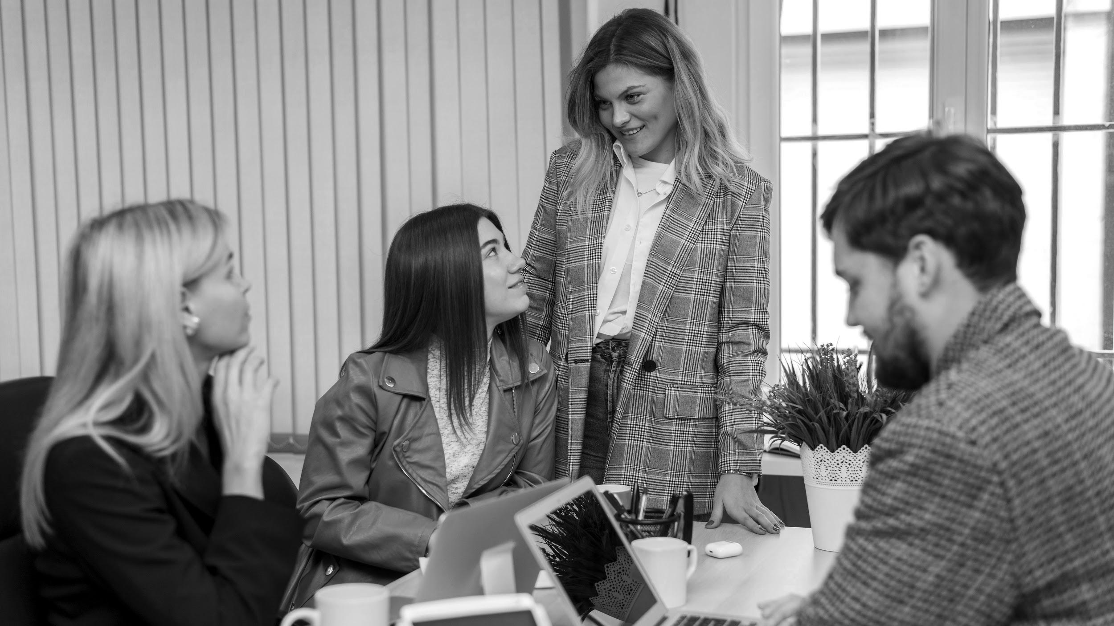
A PICTURE IS WORTH A THOUSAND WORDS

Slide 23
AWESOME WORDS

Slide 24
AWARDS
MERCURY
JUPITER
NEPTUNE
Mercury is the smallest planet
Jupiter is the biggest planet
Neptune is the farthest planet
MARS
VENUS
SATURN
Mars is a very cold place
Venus is the second planet
Saturn is the ringed one

Slide 25
OUR PARTNERS
MARS
SATURN
This planet is full of iron oxide dust
Saturn is the ringed one
MERCURY
VENUS
Mercury is the smallest one
Venus is the second planet

Slide 26
4,498,300
Big numbers catch your audience’s attention

Slide 27
333,000.00
OUR NUMBERS
24h 37m 23s
6,371 km
earths is the Sun’s mass
is Jupiter’s rotation period
is Earth’s radius

Slide 28
OUR PROCESS
01
STEP 1
This planet is full of iron oxide dust
02
STEP 2
Saturn is the ringed one
03
STEP 3
Mercury is the smallest one

Slide 29
OUR CONSULTANTS
HELENA JAMES
JOHN DAVIS
Here you can talk about this person
Here you can talk about this person
JENNA DOE
DAVID GREEN
Here you can talk about this person
Here you can talk about this person

Slide 30
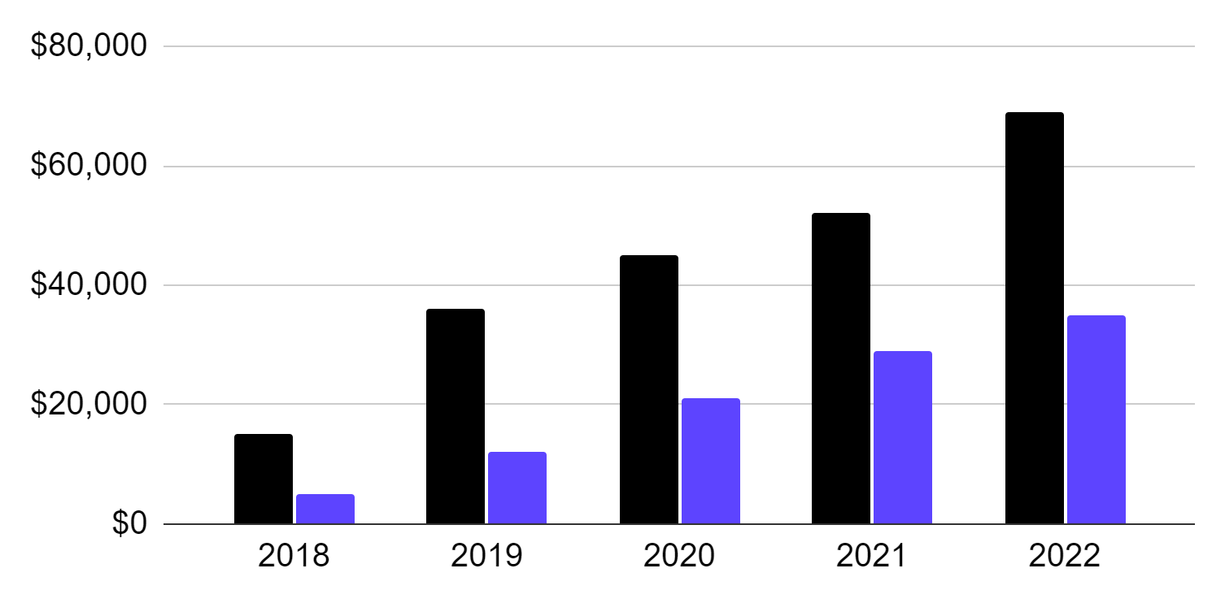
PROFIT AND LOSS FORECAST
MARS
SALES
NET PROFIT
To modify this graph, click on it, follow the link, change the data and paste the new graph here

Slide 31
SWOT ANALYSIS
STRENGTHS
S
W
WEAKNESSES
Strength 1
Strength 2
Strength 3
Weakness 1
Weakness 2
Weakness 3
OPPORTUNITIES
O
T
THREATS
Opportunity 1
Opportunity 2
Opportunity 3
Threat 1
Threat 2
Threat 3

Slide 32
RECOMMENDATIONS
 | MAY | JUN | JUL | AUG | SEP | OCT | NOV
Name of initiative 1
Name of initiative 2
Name of initiative 3
Name of initiative 4

Slide 33
PRICING MANAGEMENT PROJECT
# | Opportunities | Total of Business Opportunities | Low Margin | High Margin | Ease of Implementation
1 | Mars | $1020 | $500 | $700 | 10%
2 | Mercury | $4896 | $2400 | $3200 | 30%
3 | Jupiter | $2569 | $1200 | $1800 | 45%

Slide 34
TESTIMONIALS
JOHN GREEN
JENNA DOE
HELENA JAMES
“Mercury is the closest planet to the Sun and the smallest one”
“Venus has a beautiful name and is the second planet from the Sun”
“Jupiter is a gas giant and it is the biggest planet in the Solar System”

Slide 35
LEAN BUSINESS CASE
PROJECT COSTS
TANGIBLE BENEFITS
$4M
$14,896,236
NPV
CASH FLOW
$8M
7K
5K
3K
RESOURCES
-2K
156 items
-4K

Slide 36
LEAN BUSINESS CASE
INTANGIBLE BENEFITS
STRATEGIC ALIGNMENT
IMPACT
Mercury
Mars
Jupiter
Neptune
Mercury
Mars
Jupiter
Neptune
Low
High
PROJECT SPONSOR
PROJECT MANAGER
CHANGE
MANAGER
John Doe
Anna James
Jim Green

Slide 37
OPPORTUNITIES & SOLUTIONS
OPPORTUNITIES
SOLUTIONS
Mars
Neptune
Mercury
Venus
Jupiter
Saturn

Slide 38
DELIVERABLES & OUTCOMES
KEY
ACTIVITIES
KEY OUTCOMES
Mars
Mercury
Mars
Mercury
DELIVERABLES
OBJECTIVES
Mars
Mercury
Mars
Mercury

Slide 39
PROJECT COSTS
 | 2017 | 2018 | 2019 | 2020
COST ITEM 1 | 0.15 | 0.25 | 0.15 | 0.15
COST ITEM 2 | 0.25 | 0.35 | 0.35 | 0.25
COST ITEM 3 | 0.35 | 0.45 | 0.55 | 0.35

Slide 40
CHANGE IMPACT ASSESSMENT
Impact
Extreme
Low
High
Moderate
COMPLEXITY OF THE CHANGE
Medium
Medium
High
Moderate
Extreme
Low
1 team impacted
1 business unit
1 division
½ of the company
Extreme
SIZE OF THE CHANGE

Slide 41
RISK ASSESSMENT
RISK TITLE | PROBABILITY | IMPACT | MITIGATION
Mercury | Low | High | Mercury
Jupiter | High | Moderate | Jupiter
Mars | Low | Extreme | Mars

Slide 42
EXECUTIVE SUMMARY
PROBLEM & SOLUTION
MARKET ANALYSIS
MISSION & VISION
Mercury is the smallest planet
Jupiter is the biggest planet
Neptune is the farthest planet
COMPETITOR ANALYSIS
CUSTOMER SEGMENTS
MARKETING PLAN
Mars is a very cold place
Venus is the second planet
Saturn is the ringed one

Slide 43
MCKINSEY 7S
STRATEGY
STRUCTURE
SYSTEMS
HARD S
SHARED VALUES
SKILLS
STAFF
STYLE
SOFT S

Slide 44
MAIN BUSINESS PROBLEMS
PROFITABILITY
NEW PRODUCT
This planet is full of iron oxide dust
Saturn is the ringed one
NEW MARKET
M&A
Mercury is the smallest one
Venus is the second planet

Slide 45
BALANCED SCORECARD
PERSPECTIVE | STRATEGIC OBJECTIVES | KEY PERFORMANCE INDICATORS | TARGETS
FINANCIAL | Mercury is the smallest planet | Neptune is the farthest planet | Venus is the second planet
CUSTOMER | Jupiter is the biggest planet | Mars is actually a cold place | Saturn is a gas giant and has rings

Slide 46
SWEET SPOT
JUPITER
NEPTUNE
Jupiter is the biggest planet
Neptune is the farthest planet
MERCURY
SWEET SPOT
Mercury is the smallest planet

Slide 47
ORGANIZATIONAL CHART
CEO
Team 1
Team 2

Slide 48
MISSION AND VISION
MISSON
Despite being red, Mars is a
cold place. It’s full of iron oxide dust, which gives the planet its reddish cast
VISION
It’s a gas giant, the biggest planet in the Solar System and the fourth-brightest object in the sky

Slide 49
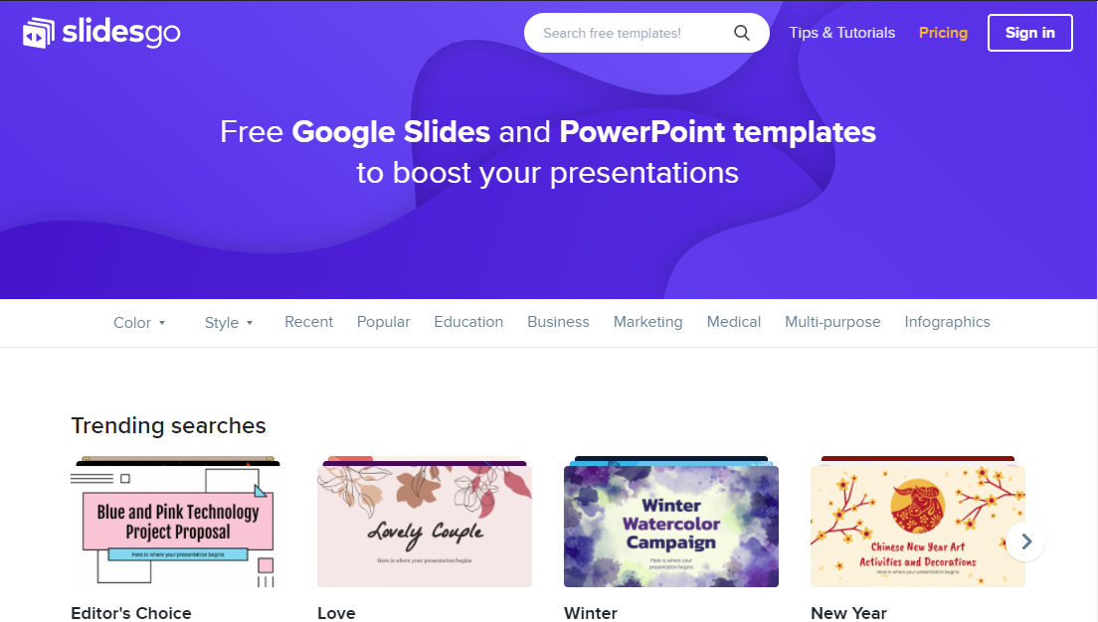
SNEAK PEEK
MERCURY
You can replace the image on the screen with your own work. Just delete this one, add yours and center it properly

Slide 50
THANKS!
Do you have any questions?
addyouremail@freepik.com +91 620 421 838 yourcompany.com
Please keep this slide for attribution

Slide 51
BUSINESS ICON PACK

Slide 52
ALTERNATIVE RESOURCES
PHOTOS
Business females working together
Man and woman working together for a new project
Business people teamwork
Corporate workers brainstorming together

Slide 53
RESOURCES
PHOTOS
High angle team meeting at office mock-up
People working on a project together
VECTORS
Flat design cms digital programs
ICONS
Business Icon Pack

Slide 54
Instructions for use
In order to use this template, you must credit Slidesgo by keeping the Thanks slide.
You are allowed to:
- Modify this template.
- Use it for both personal and commercial projects.
You are not allowed to:
- Sublicense, sell or rent any of Slidesgo Content (or a modified version of Slidesgo Content).
- Distribute Slidesgo Content unless it has been expressly authorized by Slidesgo.
- Include Slidesgo Content in an online or offline database or file.
- Offer Slidesgo templates (or modified versions of Slidesgo templates) for download.
- Acquire the copyright of Slidesgo Content.
For more information about editing slides, please read our FAQs or visit Slidesgo School:
https://slidesgo.com/faqs and https://slidesgo.com/slidesgo-school

Slide 55
Fonts & colors used
This presentation has been made using the following fonts:
Chakra Petch
(https://fonts.google.com/specimen/Chakra+Petch)
Roboto Slab
(https://fonts.google.com/specimen/Exo)
#321eb3
#5d44ff
#6c6df9
#8e9df7
#000000
#ffffff

Slide 56



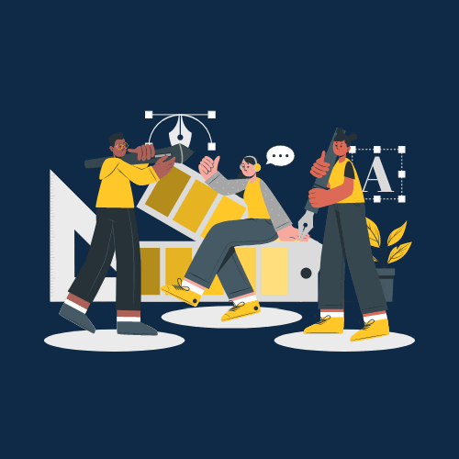

Storyset
Create your Story with our illustrated concepts. Choose the style you like the most, edit its colors, pick the background and layers you want to show and bring them to life with the animator panel! It will boost your presentation. Check out How it Works.
Pana
Amico
Bro
Rafiki
Cuate

Slide 57
Use our editable graphic resources...
You can easily resize these resources without losing quality. To change the color, just ungroup the resource and click on the object you want to change. Then, click on the paint bucket and select the color you want. Group the resource again when you’re done. You can also look for more infographics on Slidesgo.

Slide 60
JANUARY
FEBRUARY
MARCH
APRIL
MAY
JUNE
PHASE 1
Task 1
Task 2
PHASE 2
Task 1
Task 2
JANUARY
FEBRUARY
MARCH
APRIL
PHASE 1
Task 1
Task 2

Slide 63
...and our sets of editable icons
You can resize these icons without losing quality.
You can change the stroke and fill color; just select the icon and click on the paint bucket/pen.
In Google Slides, you can also use Flaticon’s extension, allowing you to customize and add even more icons.

Slide 64
Educational Icons
Medical Icons

Slide 65
Business Icons
Teamwork Icons

Slide 66
Help & Support Icons
Avatar Icons

Slide 67
Creative Process Icons
Performing Arts Icons

Slide 68
Nature Icons

Slide 69
SEO & Marketing Icons

Slide 70


